Slide 2
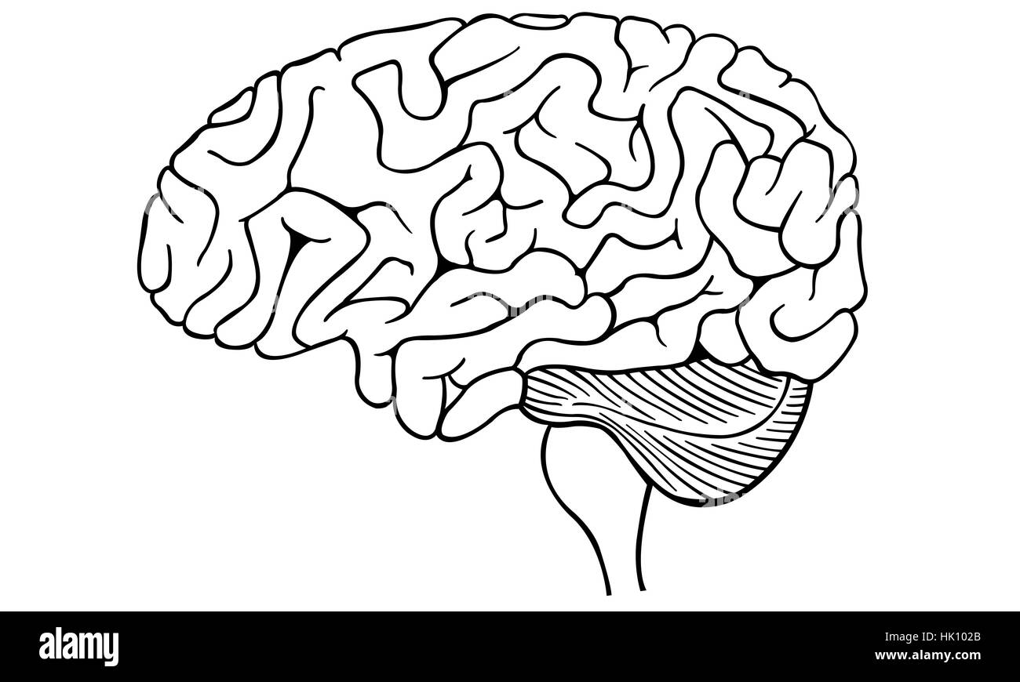
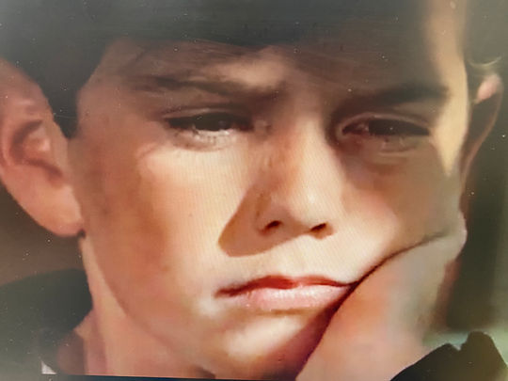
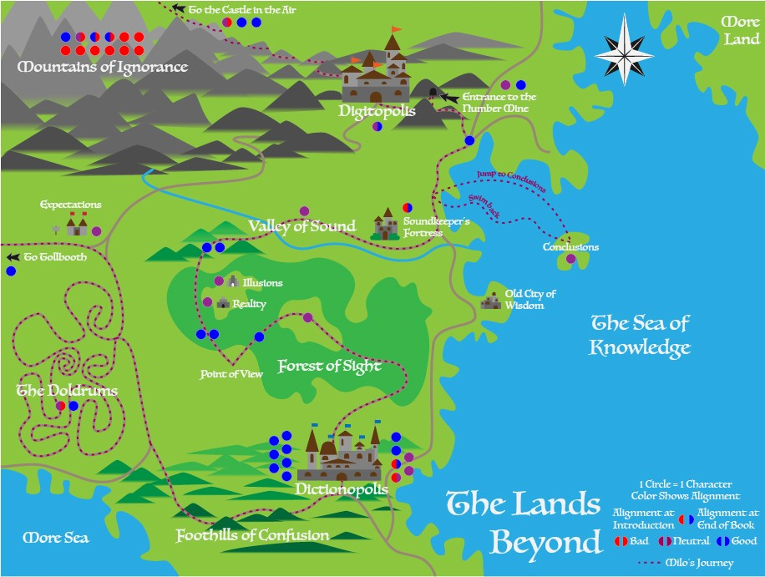

Slide 3
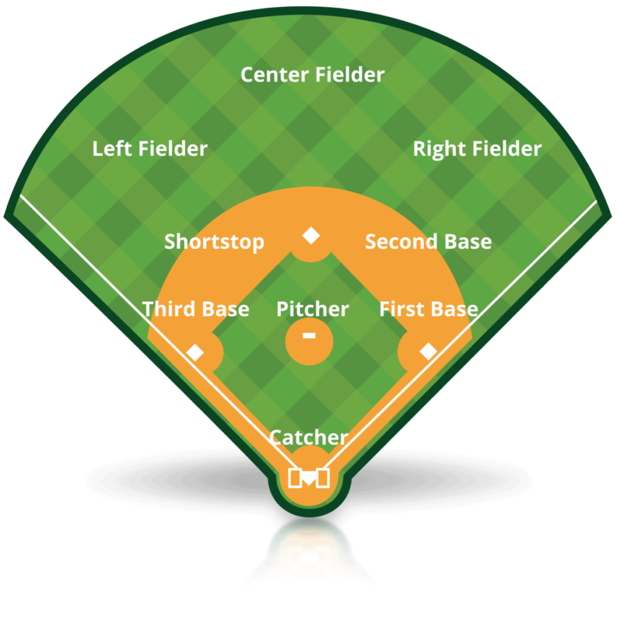
Who’s on first?
Summarize the “Who’s on first?” comedy sketch…………………………………………………………………………………………………………………………………..

Slide 4
Write a joke that uses a pun and explain how double meanings help create humor.

Slide 5
How does Norton Juster use double meanings and puns to create a unique story?

Slide 7
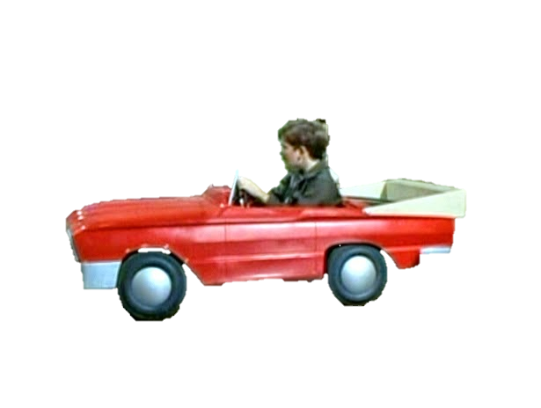

Slide 8
