Slide 1
LIFE as a grownup

Slide 2
Personality Type / Careers

Slide 3
Personality Type / Possible Careers

Slide 4
Job Description / Annual Salary? Monthly Gross Salary? Net Salary (with taxes taken out)

Slide 5
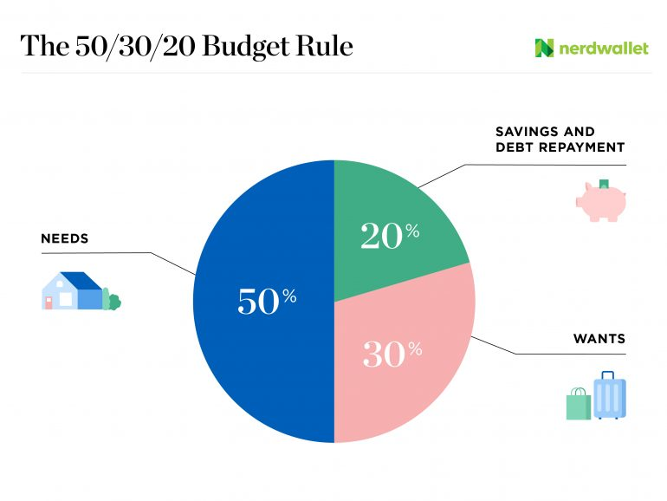
Net Salary: List your “needs” 50% of your net salary.

Slide 6
Net Salary: List your “Saving and debt reduction” 20% of your net salary.
How much money will you have if you save $100 each month for 5 years / 10 years /20 years

Slide 7
Net Salary: List your “wants” 30% of your net salary.

Slide 8
Your House/Apartment and Car: include monthly payments

